Slide 1




Slide 2

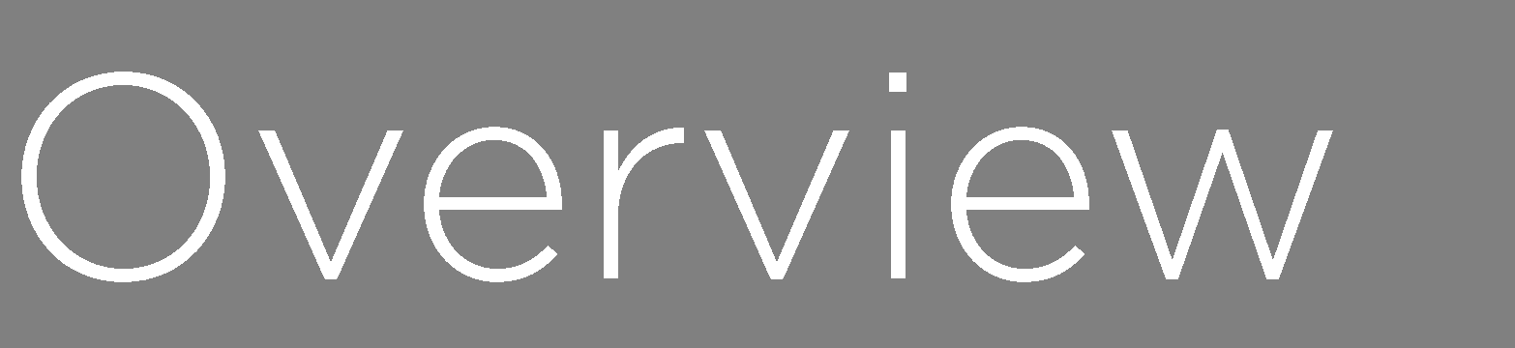


Slide 3














Slide 4
















Slide 5




Slide 6






















Slide 7


Slide 8





Slide 9



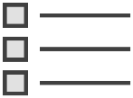

















Given… When… Then…
Given… When… Then…

Slide 10
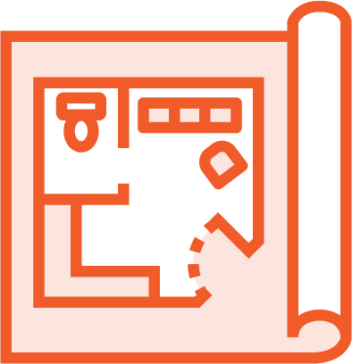







Slide 11





Slide 12






Slide 13
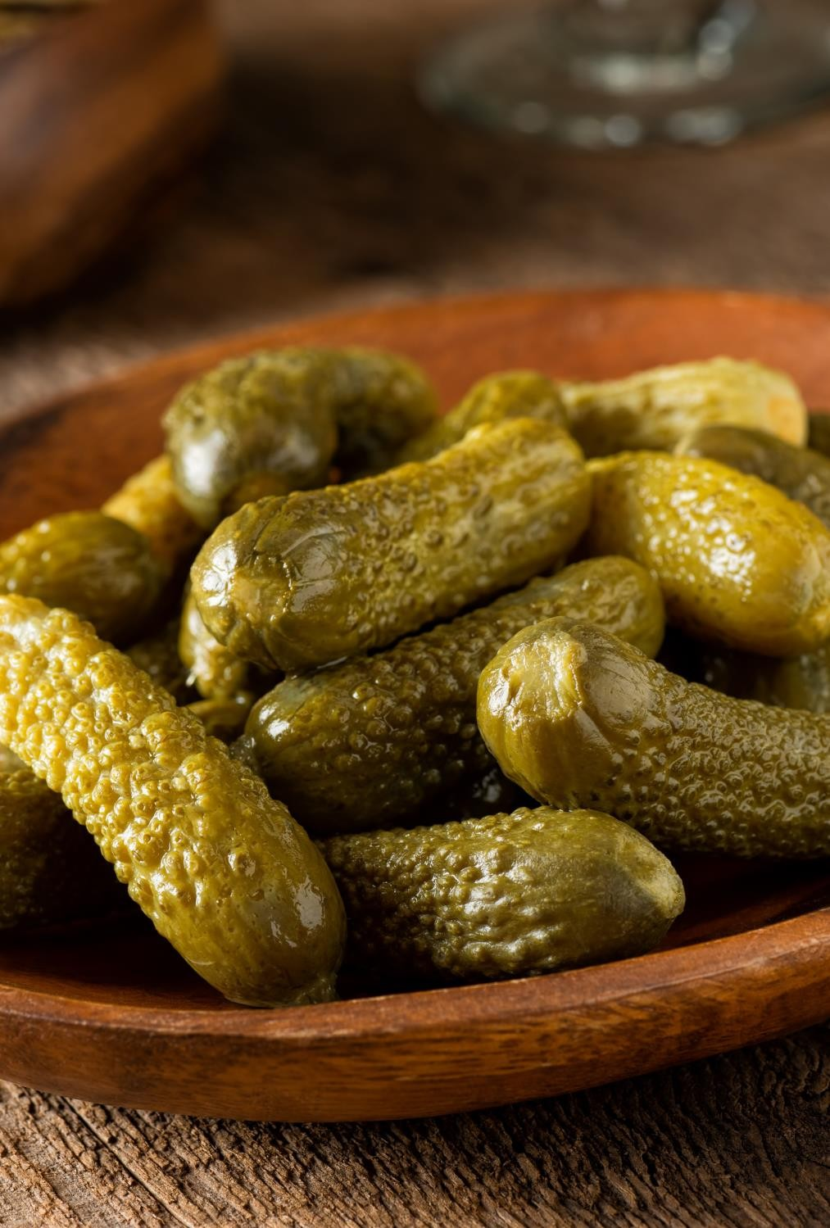





-
-

Slide 14



Feature: Viewing upcoming orders
In order to plan my morning routine As a Morning Freshness customer
I want to the status of my upcoming orders
Scenario: Michael views his current orders Given Michael is a Morning Freshness member And he has ordered a "Green Goodness Smoothie" When he views his upcoming orders
Then he should see the following orders:
| Order | Status |
| Green Goodness Smoothie | Ordered |

Slide 15





Feature: Viewing upcoming orders
In order to plan my morning routine As a Morning Freshness customer
I want to the status of my upcoming orders
Scenario: Michael views his current orders Given Michael is a Morning Freshness member And he has ordered a "Green Goodness Smoothie" When he views his upcoming orders
Then he should see the following orders:
| Order | Status |
| Green Goodness Smoothie | Ordered |

Slide 16


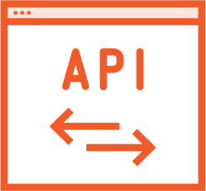



Scenario: Michael views his current orders Given Michael is a Morning Freshness member And he has ordered a "Green Goodness Smoothie" When he views his upcoming orders
Then he should see the following orders:
| Order | Status |
| Green Goodness Smoothie | Ordered |
@Given("(.*) is a Morning Freshness member")
public void a_morning_freshness_member(String name) {
registerAMorningFreshnessMember.named(name);
}

Slide 17

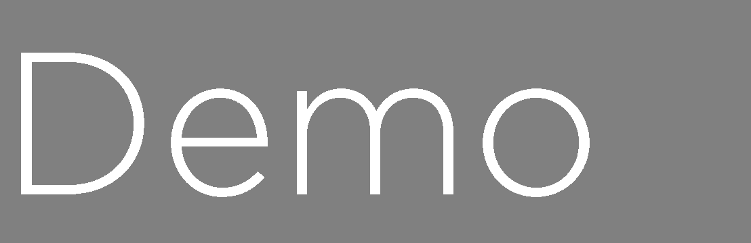
-
-

Slide 18
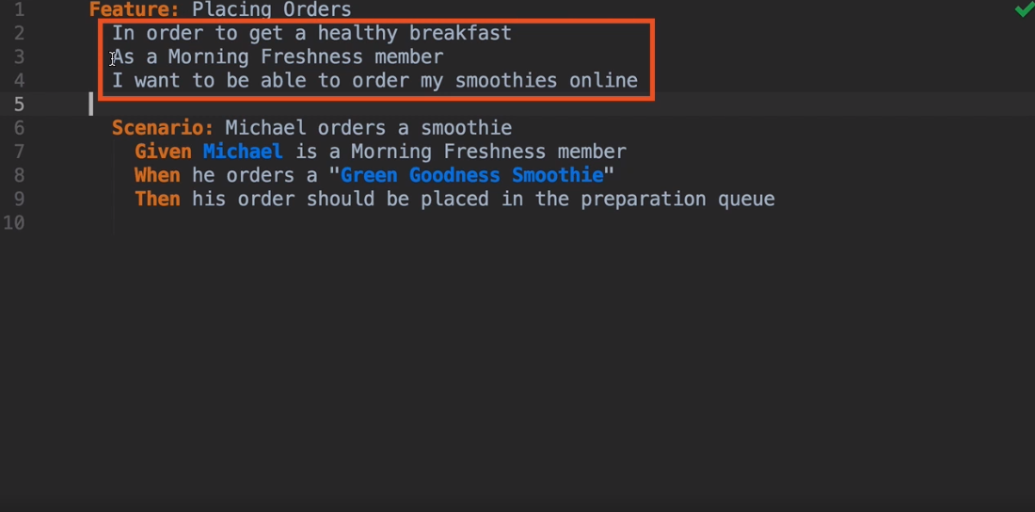

Slide 19
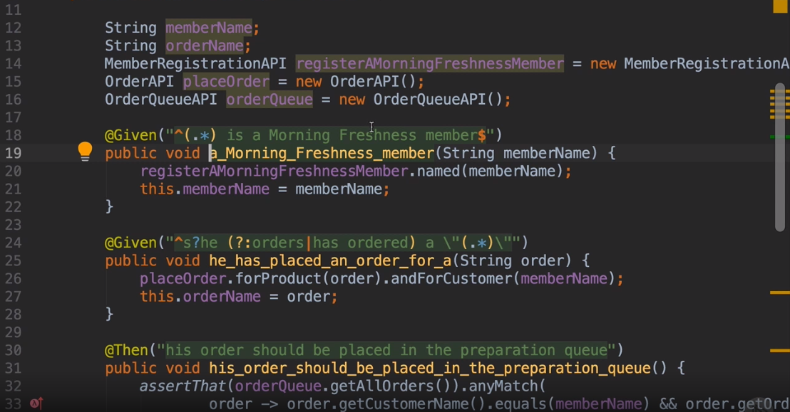

Slide 20
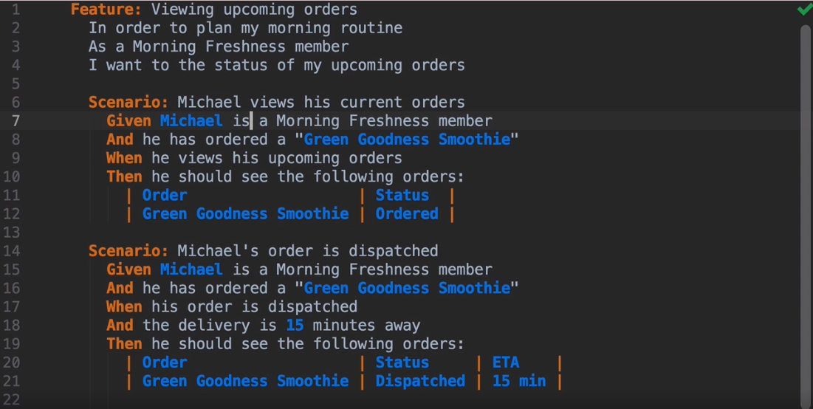

Slide 22
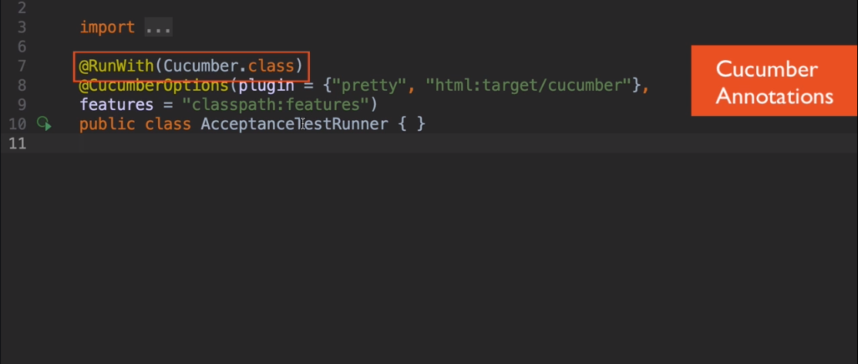

Slide 23
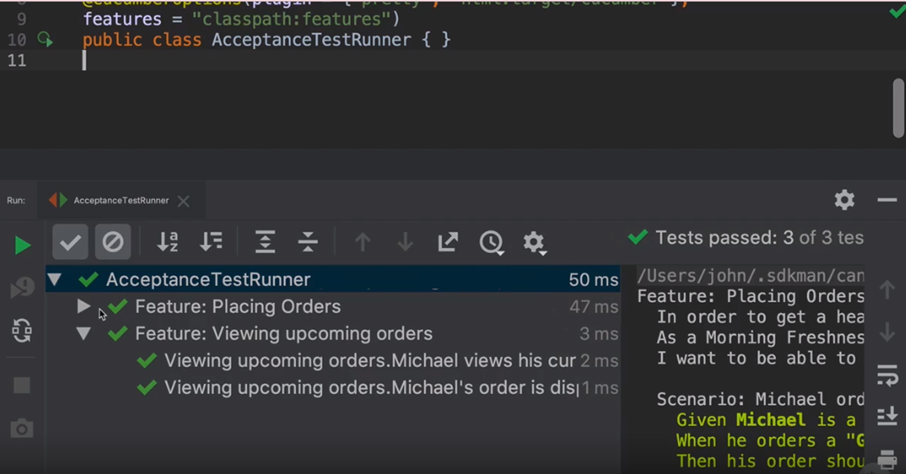

Slide 24









